Slide 1
Chapter 5
Large and Fast: Exploiting Memory Hierarchy
Notes:
Morgan Kaufmann Publishers
Chapter 5 — Large and Fast: Exploiting Memory Hierarchy

Slide 2

Address Subdivision
Chapter 5 — Large and Fast: Exploiting Memory Hierarchy — <number>
Notes:
Morgan Kaufmann Publishers
Chapter 5 — Large and Fast: Exploiting Memory Hierarchy

Slide 3
Example: Larger Block Size
64 blocks, 16 bytes/block
  To what block number does address 1200 map?
Block address = ⎣1200/16⎦ = 75
Block number = 75 modulo 64 = 11
31
10
9
4
3
0
Tag
Index
Offset
22 bits
6 bits
4 bits
Chapter 5 — Large and Fast: Exploiting Memory Hierarchy — <number>
Notes:
Morgan Kaufmann Publishers
Chapter 5 — Large and Fast: Exploiting Memory Hierarchy

Slide 4
Block Size Considerations
Larger blocks should reduce miss rate
  Due to spatial locality
But in a fixed-sized cache
  Larger blocks ⇒ fewer of them
    More competition ⇒ increased miss rate
  Larger blocks ⇒ pollution
Larger miss penalty
  Can override benefit of reduced miss rate
  Early restart and critical-word-first can help
Chapter 5 — Large and Fast: Exploiting Memory Hierarchy — <number>
Notes:
Morgan Kaufmann Publishers
Chapter 5 — Large and Fast: Exploiting Memory Hierarchy

Slide 5
Cache Misses
On cache hit, CPU proceeds normally
On cache miss
  Stall the CPU pipeline
  Fetch block from next level of hierarchy
  Instruction cache miss
    Restart instruction fetch
  Data cache miss
    Complete data access
Chapter 5 — Large and Fast: Exploiting Memory Hierarchy — <number>
Notes:
Morgan Kaufmann Publishers
Chapter 5 — Large and Fast: Exploiting Memory Hierarchy

Slide 6
Write-Through
On data-write hit, could just update the block in cache
  But then cache and memory would be inconsistent
Write through: also update memory
But makes writes take longer
  e.g., if base CPI = 1, 10% of instructions are stores, write to memory takes 100 cycles
    Effective CPI = 1 + 0.1×100 = 11
Solution: write buffer
  Holds data waiting to be written to memory
  CPU continues immediately
    Only stalls on write if write buffer is already full
Chapter 5 — Large and Fast: Exploiting Memory Hierarchy — <number>
Notes:
Morgan Kaufmann Publishers
Chapter 5 — Large and Fast: Exploiting Memory Hierarchy

Slide 7
Write-Back
Alternative: On data-write hit, just update the block in cache
  Keep track of whether each block is dirty
When a dirty block is replaced
  Write it back to memory
  Can use a write buffer to allow replacing block to be read first
Chapter 5 — Large and Fast: Exploiting Memory Hierarchy — <number>
Notes:
Morgan Kaufmann Publishers
Chapter 5 — Large and Fast: Exploiting Memory Hierarchy

Slide 8
Write Allocation
What should happen on a write miss?
Alternatives for write-through
  Allocate on miss: fetch the block
  Write around: don’t fetch the block
    Since programs often write a whole block before reading it (e.g., initialization)
For write-back
  Usually fetch the block
Chapter 5 — Large and Fast: Exploiting Memory Hierarchy — <number>
Notes:
Morgan Kaufmann Publishers
Chapter 5 — Large and Fast: Exploiting Memory Hierarchy

Slide 9
Example: Intrinsity FastMATH
Embedded MIPS processor
  12-stage pipeline
  Instruction and data access on each cycle
Split cache: separate I-cache and D-cache
  Each 16KB: 256 blocks × 16 words/block
  D-cache: write-through or write-back
SPEC2000 miss rates
  I-cache: 0.4%
  D-cache: 11.4%
  Weighted average: 3.2%
Chapter 5 — Large and Fast: Exploiting Memory Hierarchy — <number>
Notes:
Morgan Kaufmann Publishers
Chapter 5 — Large and Fast: Exploiting Memory Hierarchy

Slide 10

Example: Intrinsity FastMATH
Chapter 5 — Large and Fast: Exploiting Memory Hierarchy — <number>
Notes:
Morgan Kaufmann Publishers
Chapter 5 — Large and Fast: Exploiting Memory Hierarchy

Slide 11
Main Memory Supporting Caches
Use DRAMs for main memory
  Fixed width (e.g., 1 word)
  Connected by fixed-width clocked bus
    Bus clock is typically slower than CPU clock
Example - cache block read
  1 bus cycle for address transfer
  15 bus cycles per DRAM access
  1 bus cycle per data transfer
Answer for 4-word block, 1-word-wide DRAM
  Miss penalty = 1 + 4×15 + 4×1 = 65 bus cycles
  Bandwidth = 4 x 4 bytes / 65 cycles = 0.25 B/cycle
How many bus cycles for a 4-word block with a DRAM width of 2-words?
Chapter 5 — Large and Fast: Exploiting Memory Hierarchy — <number>
Notes:
Morgan Kaufmann Publishers
Chapter 5 — Large and Fast: Exploiting Memory Hierarchy

Slide 12
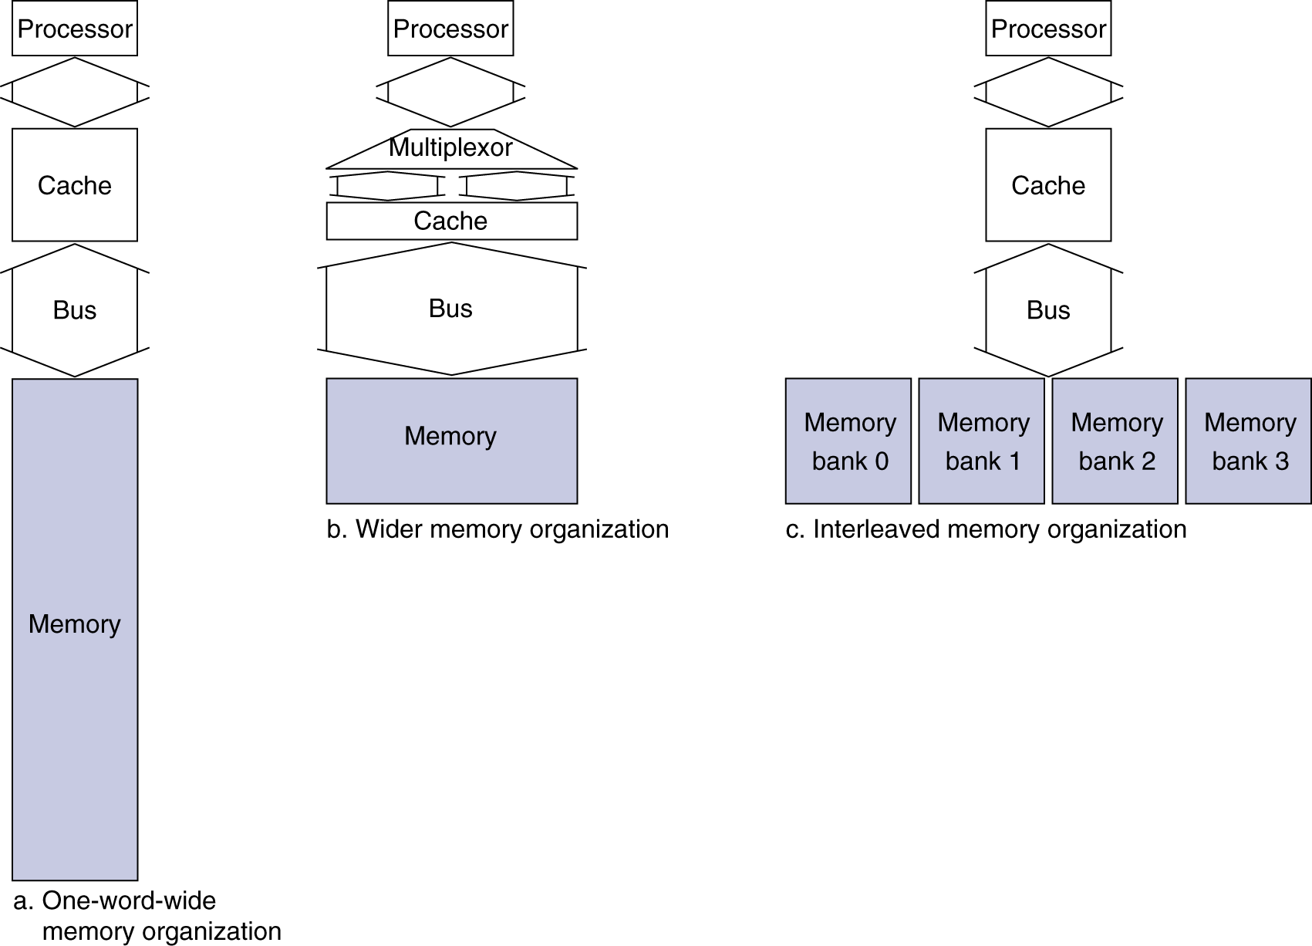
Increasing Memory Bandwidth
Answer: for 4-word wide memory
  Miss penalty = 1 + 15 + 1 = 17 bus cycles
  Bandwidth = 4 x 4 bytes / 17 cycles = 0.94 B/cycle
Answer: for 4-bank interleaved memory
  Miss penalty = 1 + 15 + 4×1 = 20 bus cycles
  Bandwidth = 4 x 4 bytes / 20 cycles = 0.8 B/cycle
Chapter 5 — Large and Fast: Exploiting Memory Hierarchy — <number>
Notes:
Morgan Kaufmann Publishers
Chapter 5 — Large and Fast: Exploiting Memory Hierarchy

Slide 13
Advanced DRAM Organization
Bits in a DRAM are organized as a rectangular array
  DRAM accesses an entire row
  Burst mode: supply successive words from a row with reduced latency
Double data rate (DDR) DRAM
  Transfer on rising and falling clock edges
Quad data rate (QDR) DRAM
  Separate DDR inputs and outputs
Chapter 5 — Large and Fast: Exploiting Memory Hierarchy — <number>
Notes:
Morgan Kaufmann Publishers
Chapter 5 — Large and Fast: Exploiting Memory Hierarchy

Slide 14
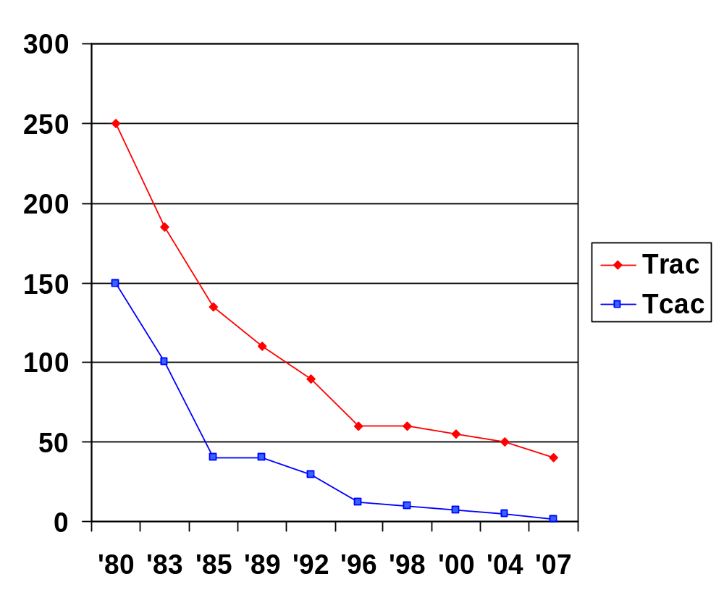
DRAM Generations
Year | Capacity | $/GB
1980 | 64Kbit | $1500000
1983 | 256Kbit | $500000
1985 | 1Mbit | $200000
1989 | 4Mbit | $50000
1992 | 16Mbit | $15000
1996 | 64Mbit | $10000
1998 | 128Mbit | $4000
2000 | 256Mbit | $1000
2004 | 512Mbit | $250
2007 | 1Gbit | $50
Chapter 5 — Large and Fast: Exploiting Memory Hierarchy — <number>
Notes:
Morgan Kaufmann Publishers
Chapter 5 — Large and Fast: Exploiting Memory Hierarchy

Slide 15
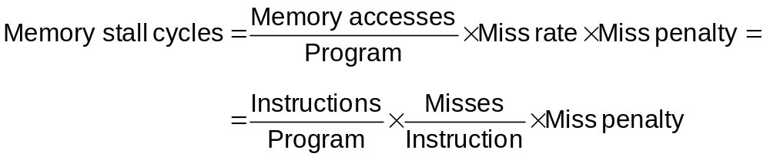
Measuring Cache Performance
Components of CPU time
  Program execution cycles
    Includes cache hit time
  Memory stall cycles
    Mainly from cache misses
With simplifying assumptions:
§5.3 Measuring and Improving Cache Performance
Chapter 5 — Large and Fast: Exploiting Memory Hierarchy — <number>
Notes:
Morgan Kaufmann Publishers
Chapter 5 — Large and Fast: Exploiting Memory Hierarchy

Slide 16
Cache Performance Example
Given
  I-cache miss rate = 2%
  D-cache miss rate = 4%
  Miss penalty = 100 cycles
  Base CPI (ideal cache) = 2
  Load & stores are 36% of instructions
Miss cycles per instruction
  I-cache: 0.02 × 100 = 2
  D-cache: 0.36 × 0.04 × 100 = 1.44
Actual CPI = 2 + 2 + 1.44 = 5.44
  The system with the perfect cache would be 5.44/2 =2.72 times faster.
Chapter 5 — Large and Fast: Exploiting Memory Hierarchy — <number>
Notes:
Morgan Kaufmann Publishers
Chapter 5 — Large and Fast: Exploiting Memory Hierarchy

Slide 17
Average Access Time
Hit time is also important for performance
Average memory access time (AMAT)
  AMAT = Hit time + Miss rate × Miss penalty
Example
  CPU with 1ns clock, hit time = 1 cycle, I-cache miss rate = 5%, miss penalty = 20 cycles,
  AMAT = 1 + 0.05 × 20 = 2 clock cycles
    2 cycles per instruction
Chapter 5 — Large and Fast: Exploiting Memory Hierarchy — <number>
Notes:
Morgan Kaufmann Publishers
Chapter 5 — Large and Fast: Exploiting Memory Hierarchy

Slide 18
Performance Summary
When CPU performance increased
  Miss penalty becomes more significant
Decreasing base CPI
  Greater proportion of time spent on memory stalls
Increasing clock rate
  Memory stalls account for more CPU cycles
Can’t neglect cache behavior when evaluating system performance
Chapter 5 — Large and Fast: Exploiting Memory Hierarchy — <number>
Notes:
Morgan Kaufmann Publishers
Chapter 5 — Large and Fast: Exploiting Memory Hierarchy

